Slide 1
Firearm Licenses & Firearm Related Homicides
A data exploration project by Daniel W. Anner
Notes:
During my presentation I wanted to originally compare firearm sales in the United States to Firearm Homicides. Unfortunately, it proved difficult to find sales numbers from legitimate trusted sources, so I have to pivot my question.
In turn I am going to try to compare and find a correlation between approved Firearm Licenses and Firearm related Homicides. I think this is something that is a talking point for Americans when talking about the second amendment, so I wanted to explore the data a bit more. I am a strong supporter of the second amendment, so this is a harder topic for me to discuss because I do have a bias. I am going to report the data straight and not interject my opinion, so you are able to form your own opinion.
Hopefully, I will be able to find out if there is any type of correlation in this data, even though it is slightly off base of what I originally wanted to explore. Lets get into the data.

Slide 2
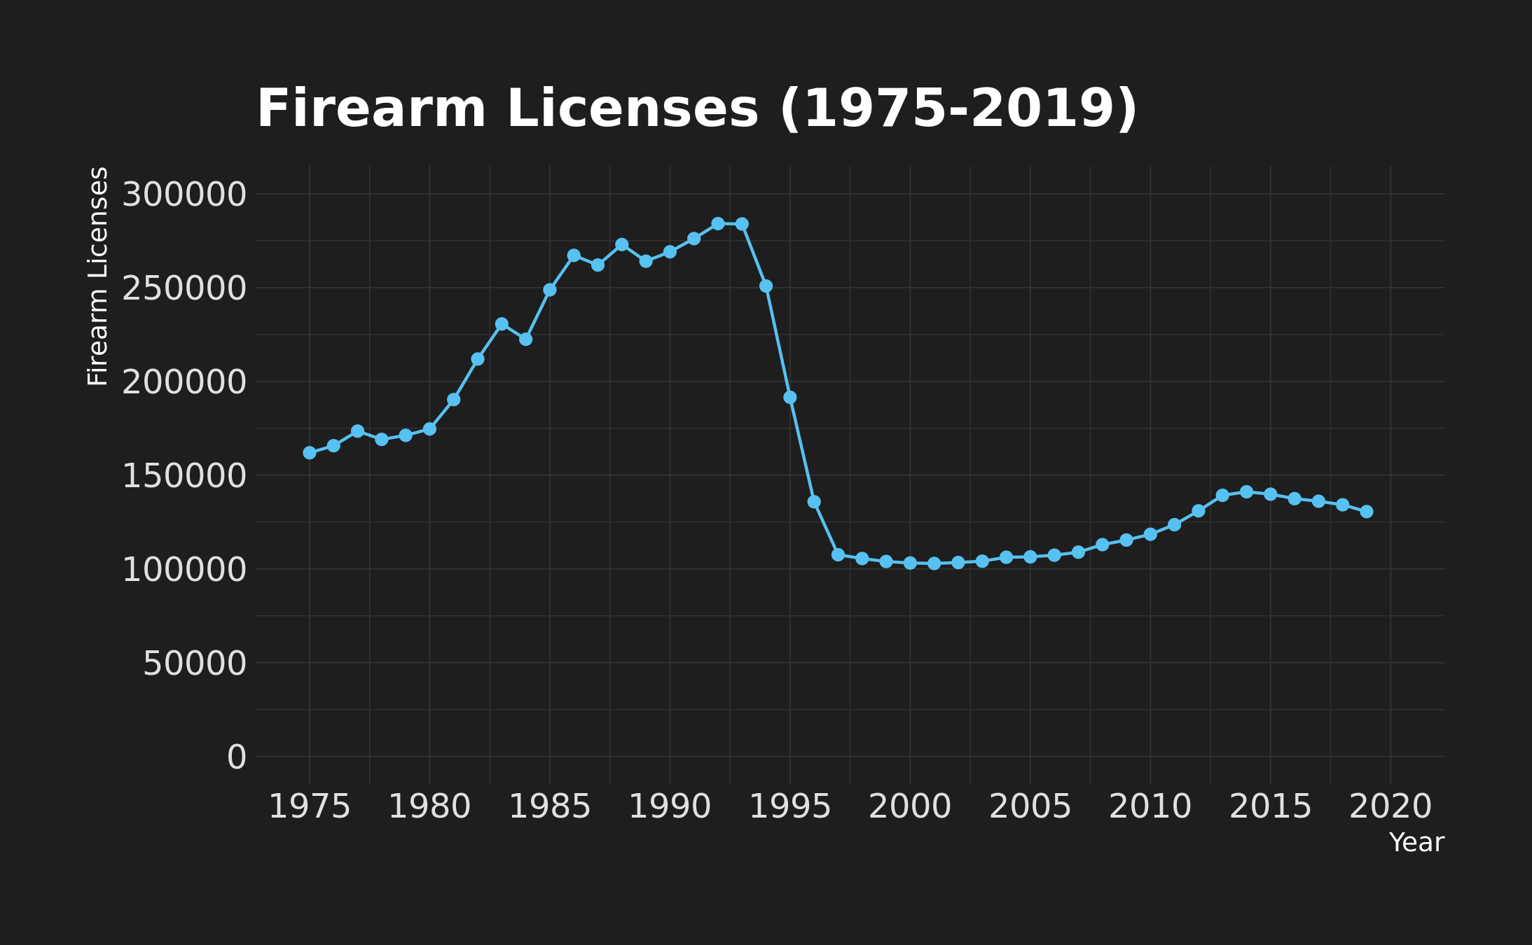
Firearm License
1992 – 241,155
Notes:
I find this chart very interesting because when analyzing data I found homicides related to firearms drastically decreases between 1933 and 2001. This is the same trend that this firearm license awards is showing, which I think is interesting. It could even lead one to believe firearm licenses being handed out less caused less homicides. What I found when I was doing research was that the screening process became much more meticulous after the early 1990’s.

Slide 3
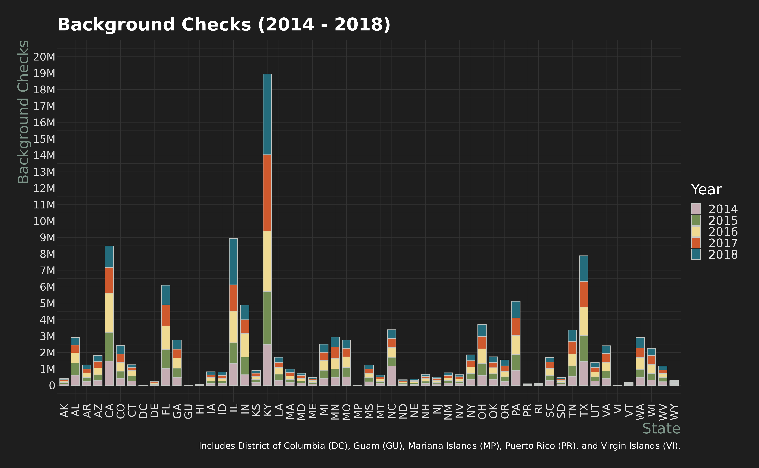
Background Checks 2014-2018
Notes:
Background checks are a big part of the screening process for federally awarded firearm licenses. From this stacked bar chart we are able to see Kentucky is the leader in background checks performed for federal firearm licenses year over year. I found it interesting to see that the 3 next highest states has almost 10 million less firearm license related background checks, in only a 5 year time span.

Slide 4
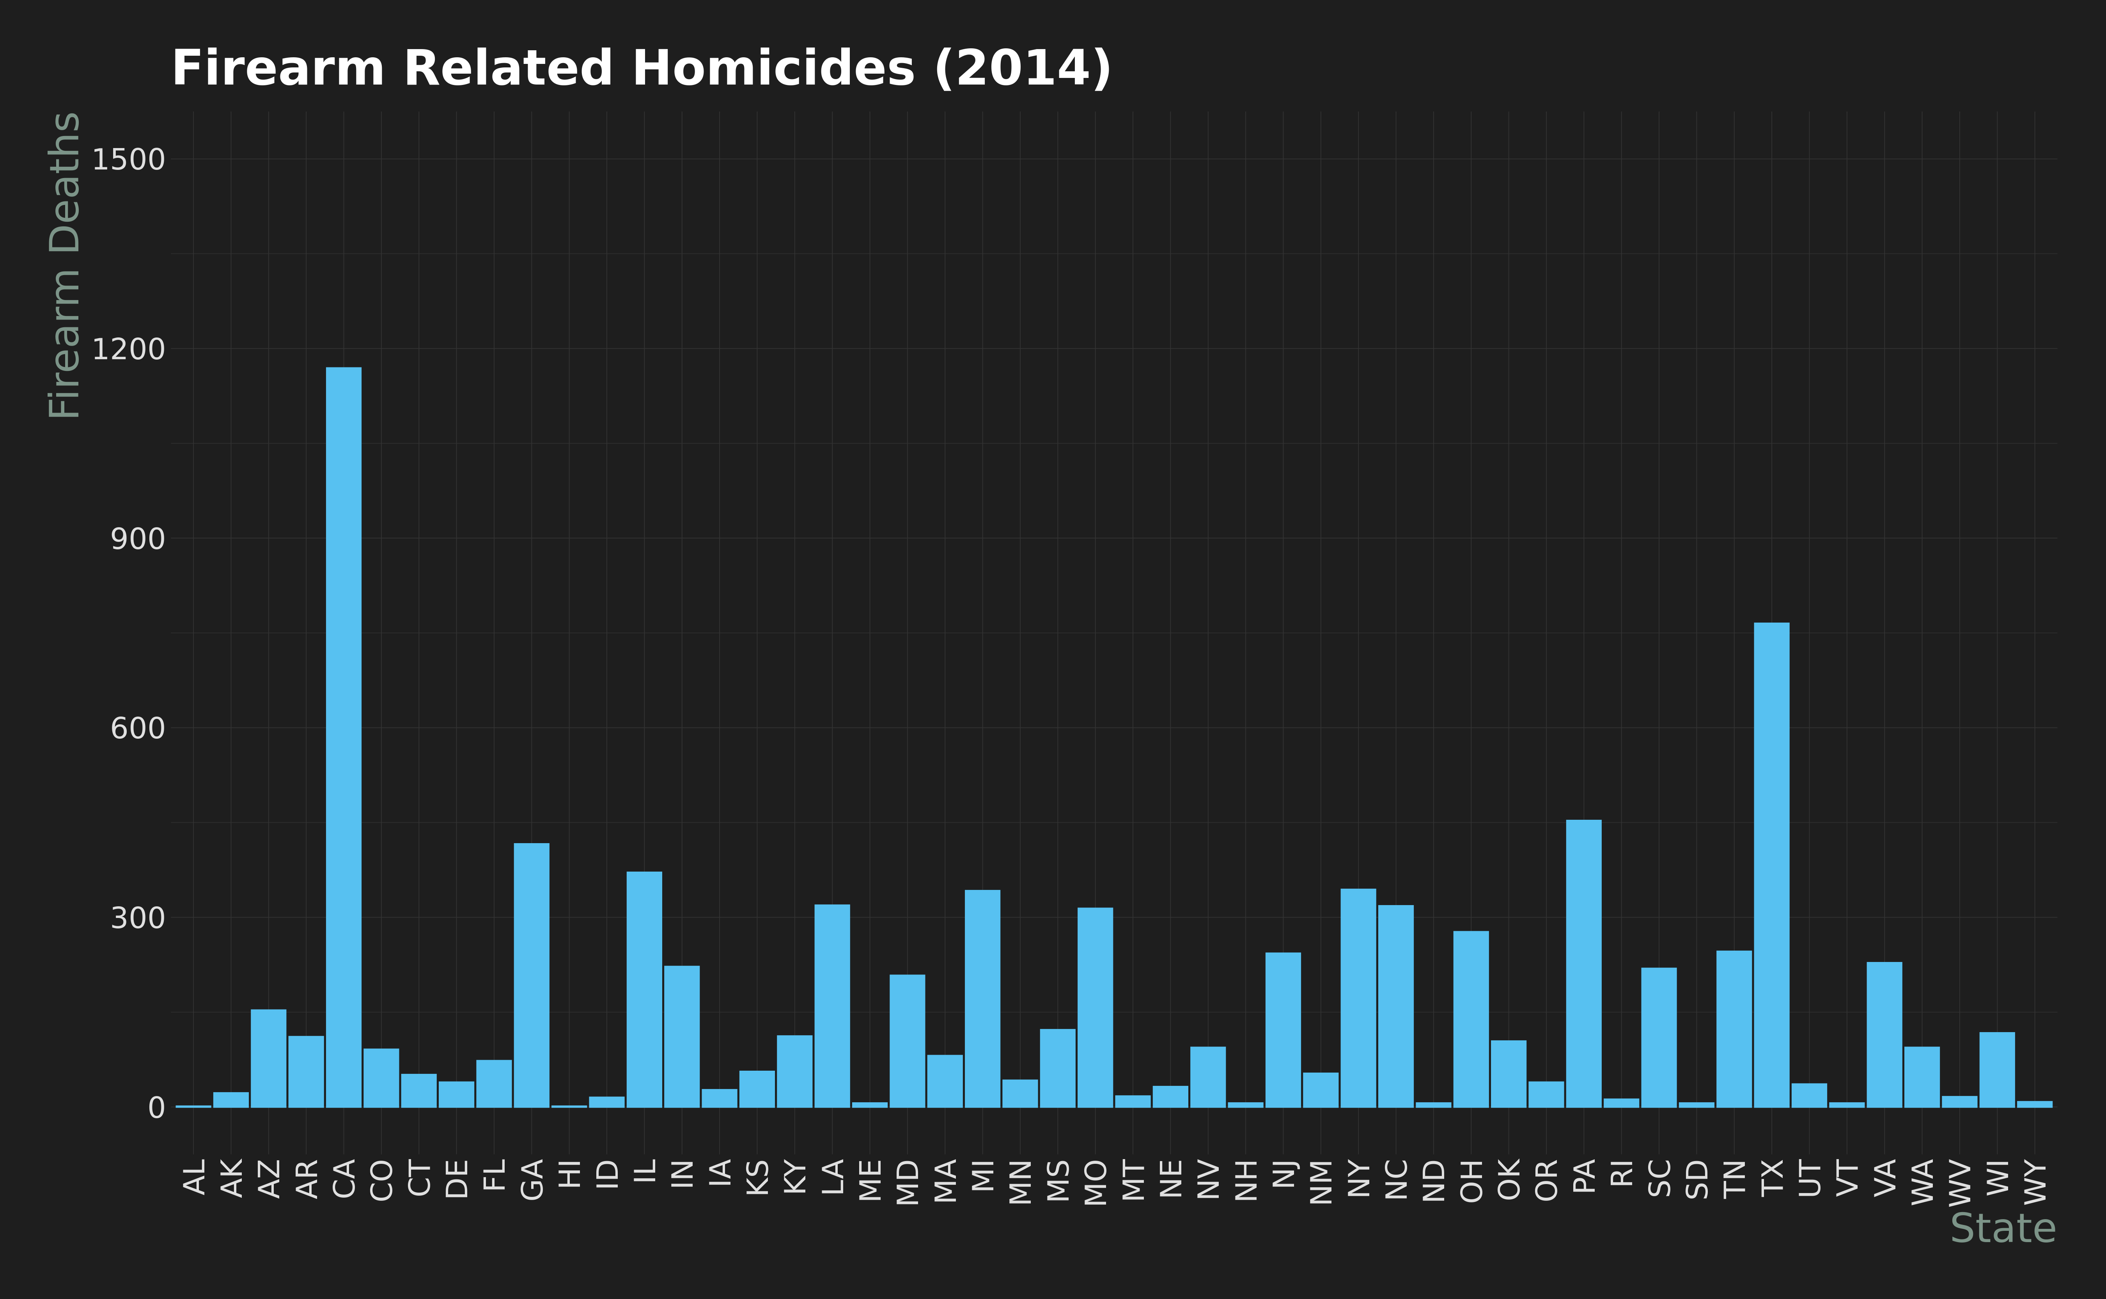
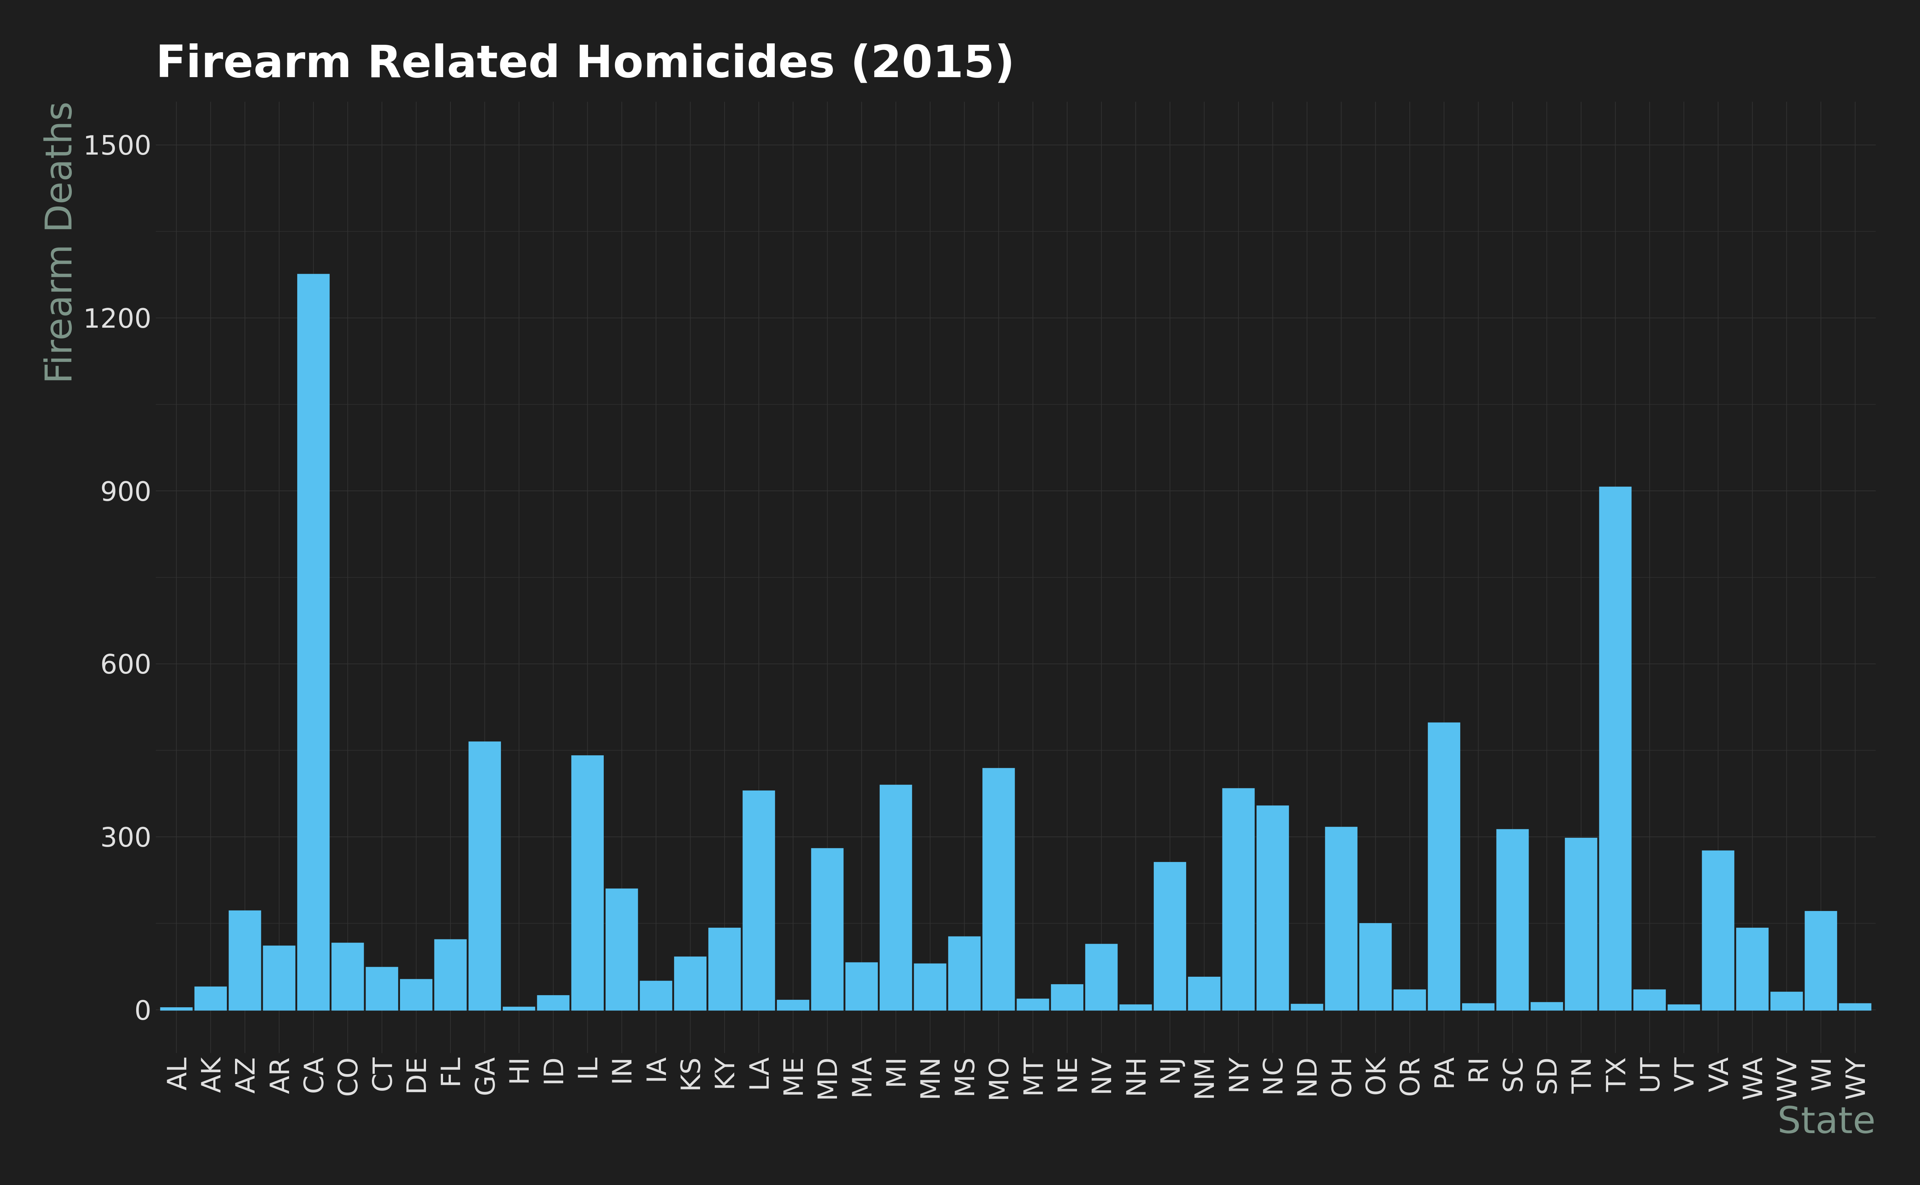
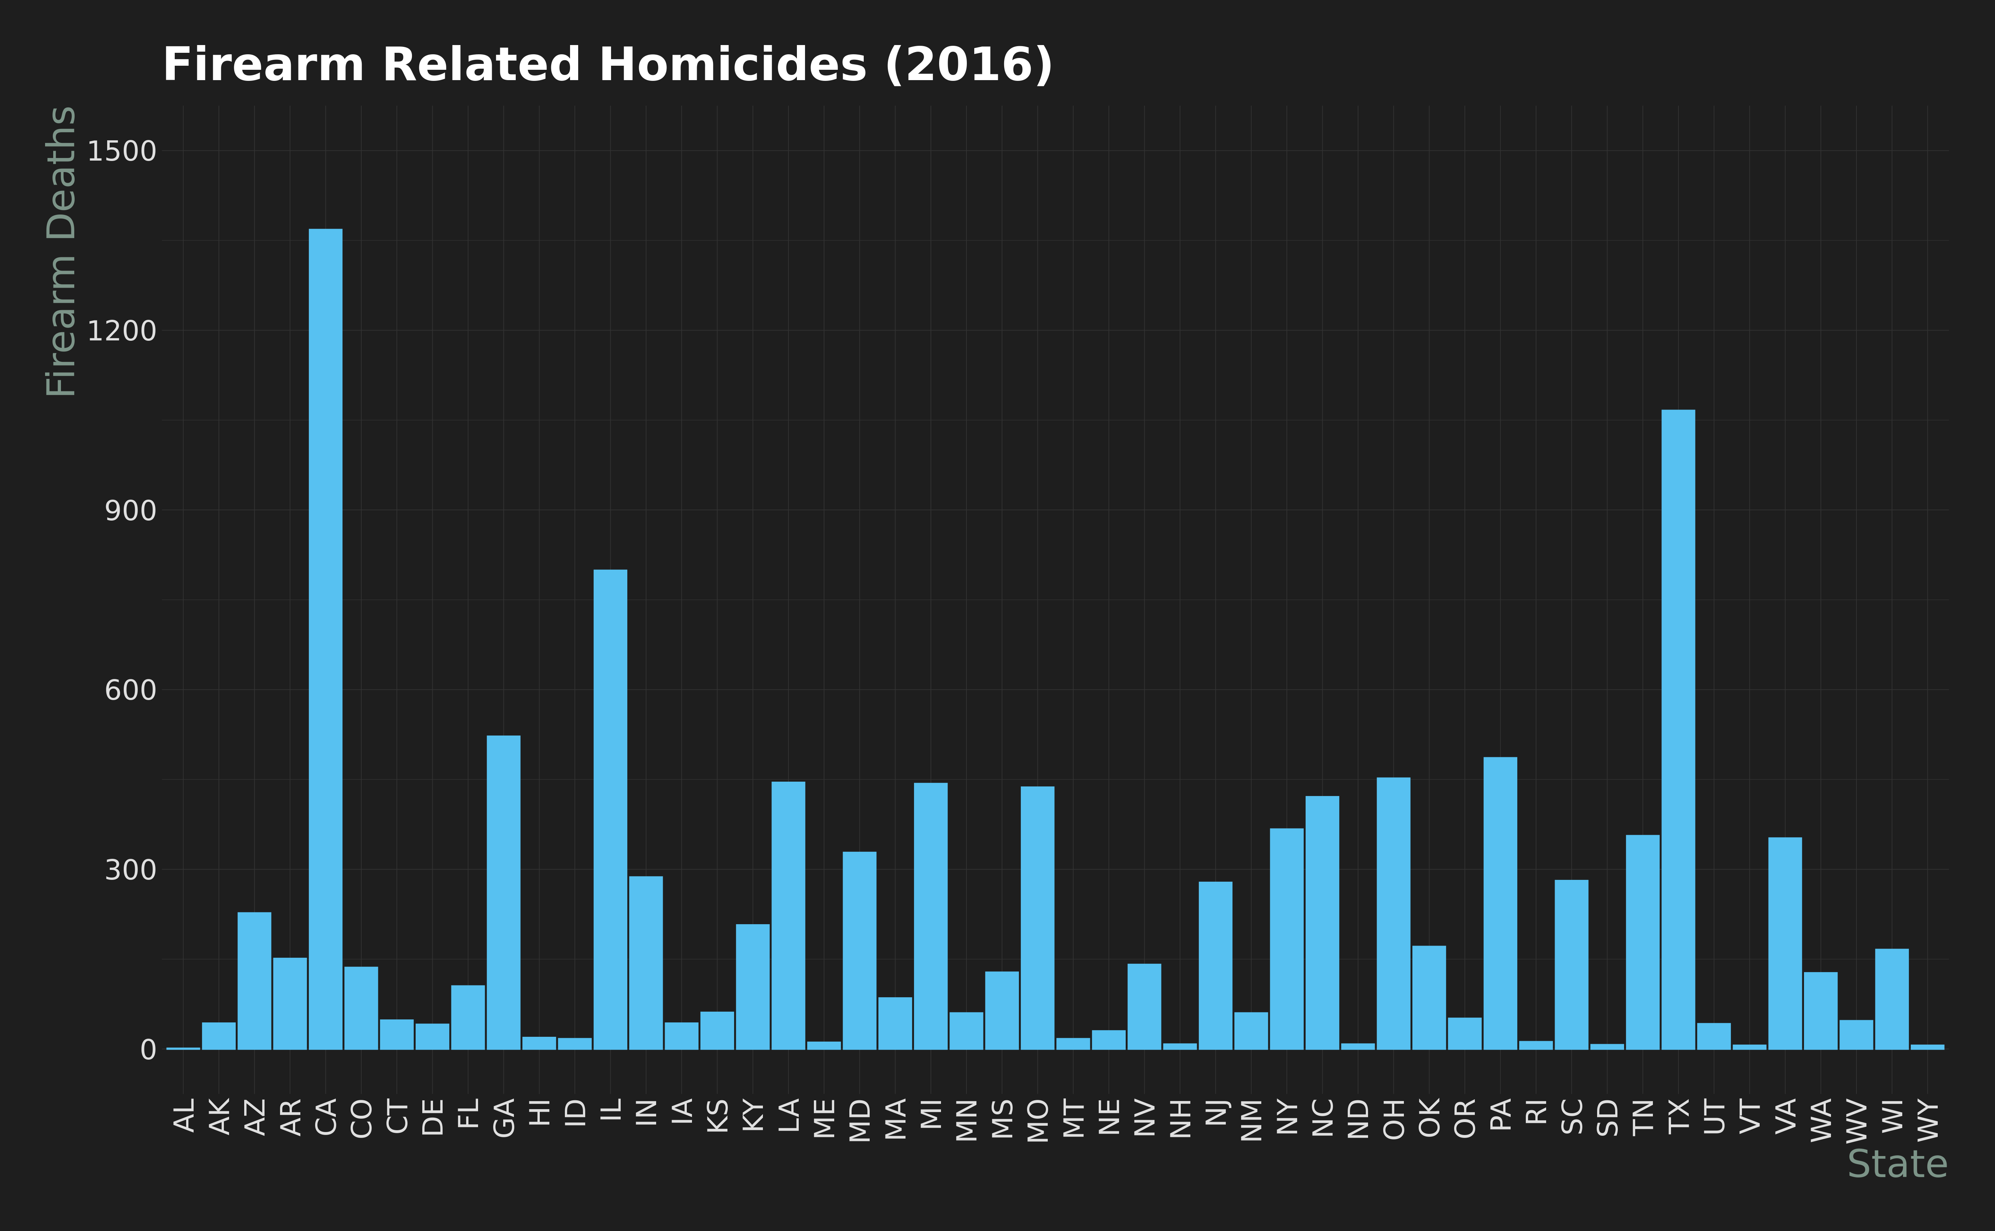
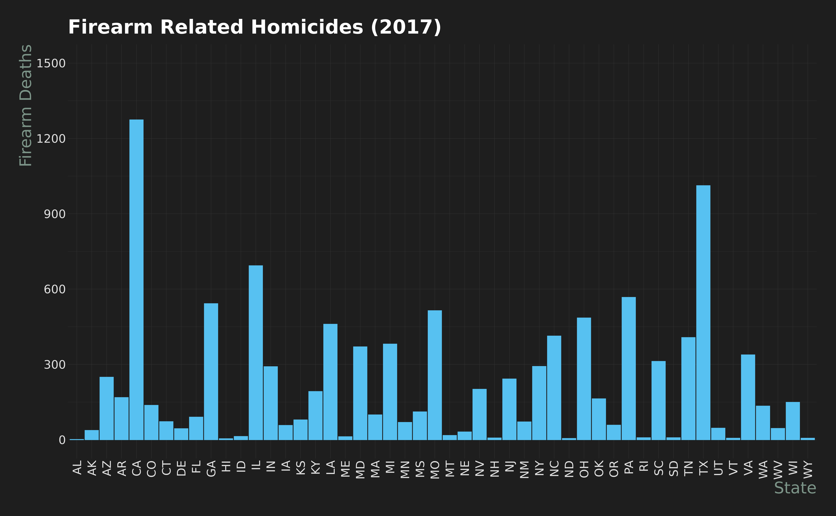
Firearm Homicides 2014-2017
Notes:
Homicide rates that relate to firearm use seem to be relatively static, with the rates not fluctuating too much. Even though California has such tough gun laws in the state, they clearly and consistently year after year have the highest amount of firearm related homicides. The next highest homicide rate due to guns Is in Texas, which is a little less surprising.

Slide 5
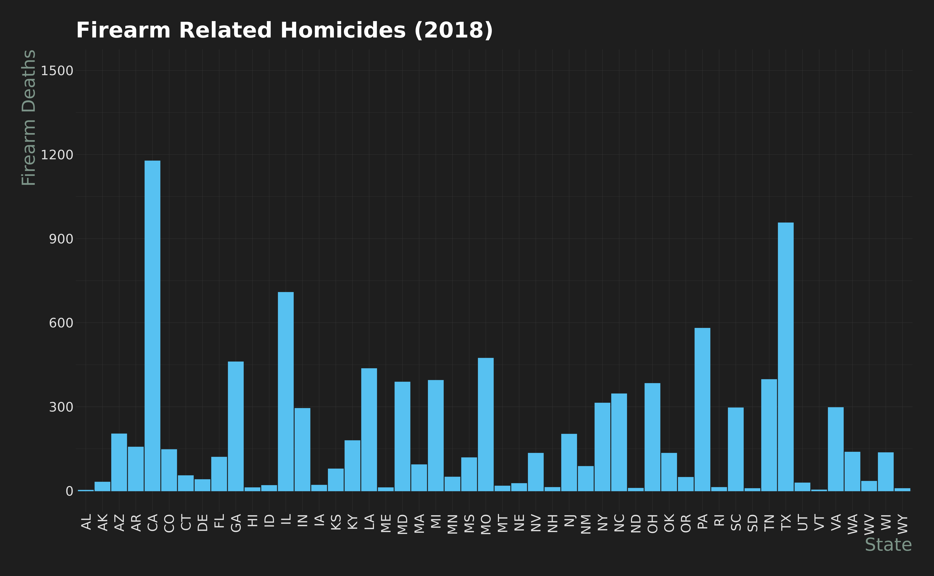
Firearm Homicides 2014-2018
Notes:
In 2018 we can see that again California is still the highest firearm related homicides in the nation with Texas actually growing. I decided not to show data dating back before 2014 since my primary focus, due to the data I could access in a short amount of time, is from 2014 to 2018.

Slide 6
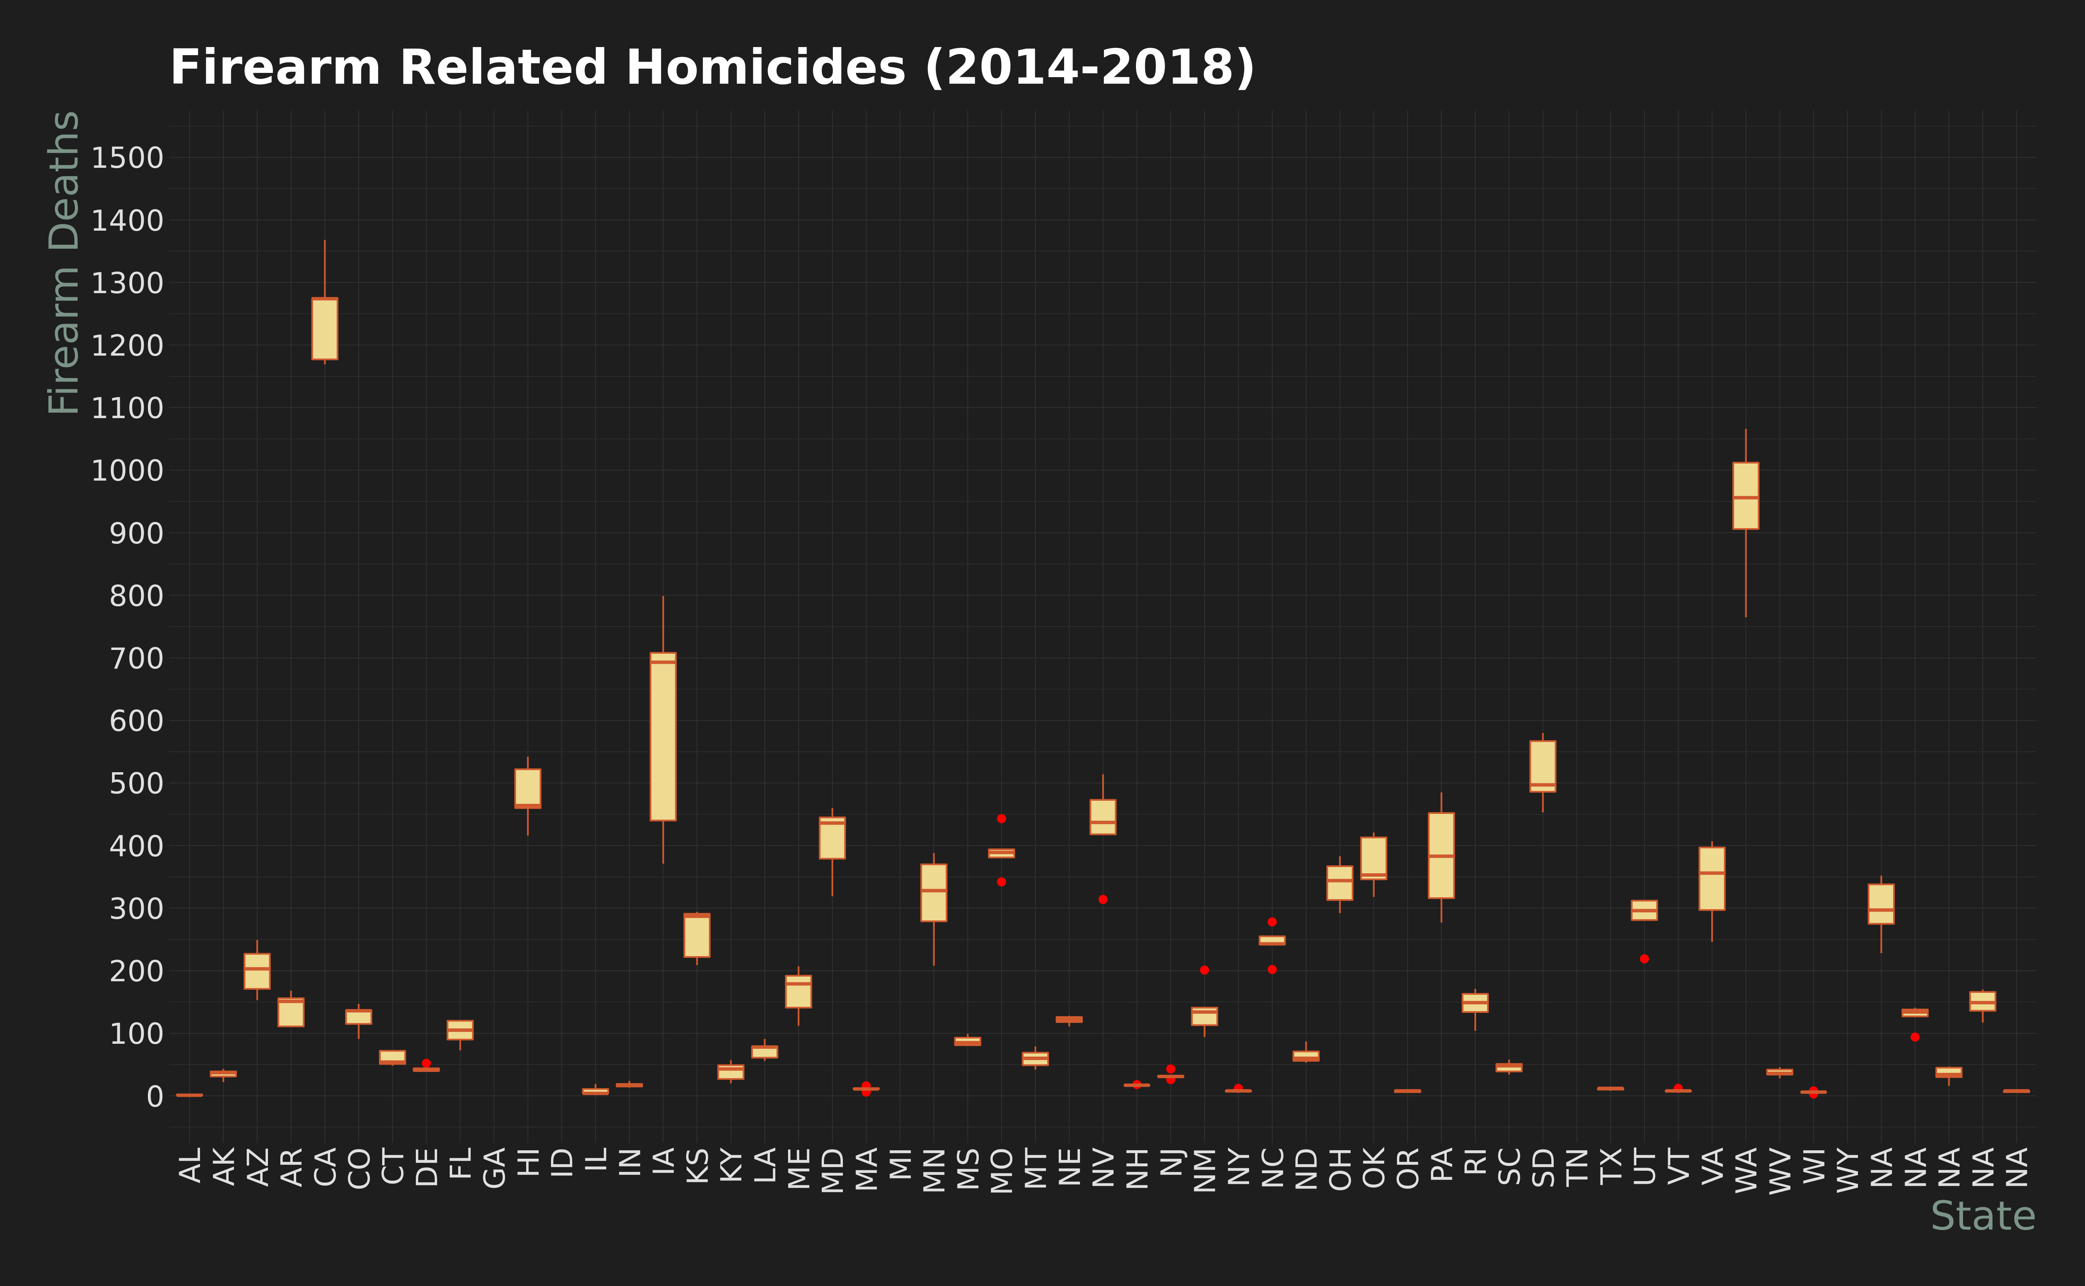
Firearm Homicides 2014-2018
Notes:
I think this chart is very important as it shows us not only where the most homicides are occurring, but also the span of the data over the 5 years. It is important to note that firearm homicide data for Florida, Guam, the Mariana Islands, Puerto Rico and the Virgin Islands was not available from the FBI databases. We can clearly see California is the leader, which is not really a surprise followed by Texas where the state of Iowa has the largest spread. From the charts we looked at previously and this one, we are able to see that Iowa is having an increasing issue with firearm related homicides. I think this visualization gives us a good overview of the states that are really having issues with firearm homicides and the ones that are getting worse, or staying the same.

Slide 7
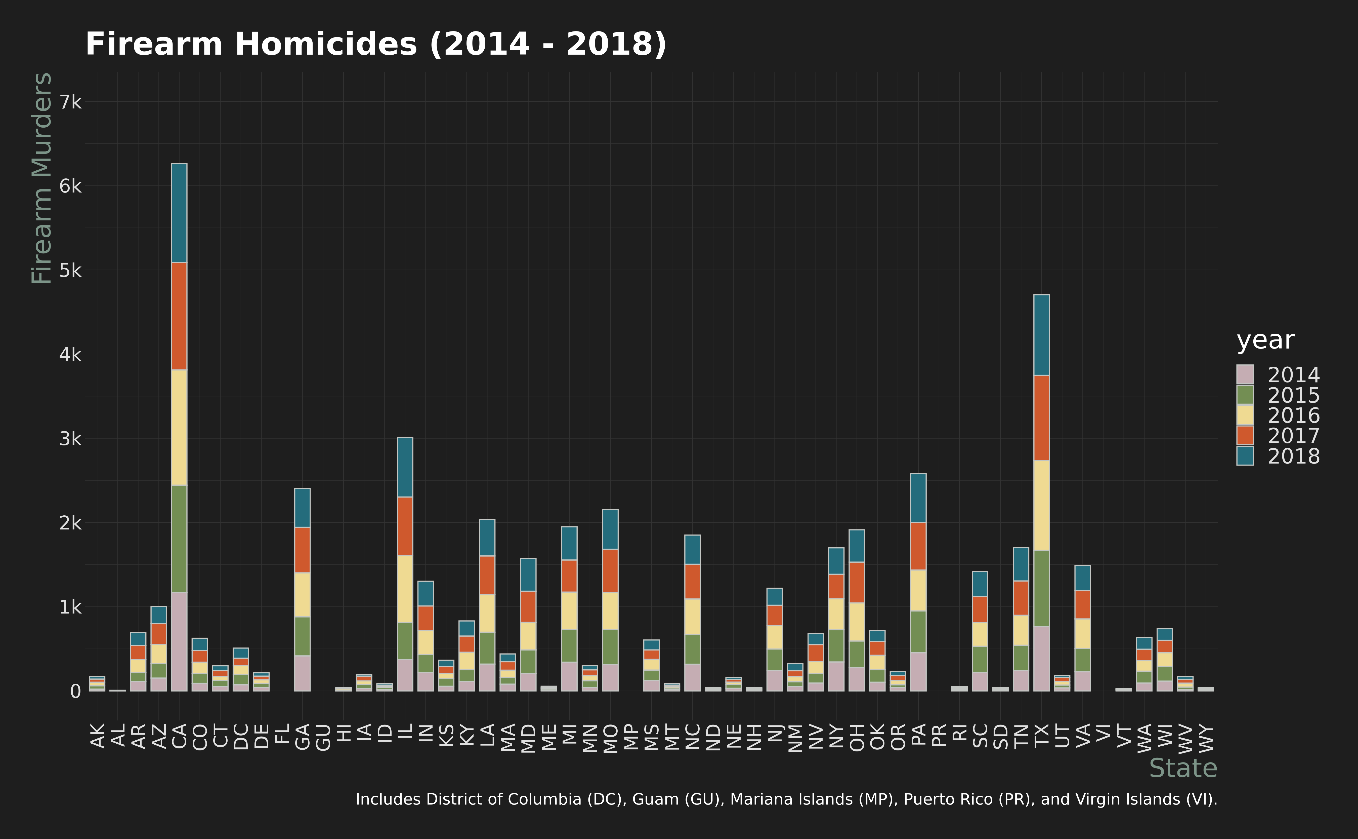
Firearm Homicides 2014-2018
Notes:
I think this chart shows us a great amount of detail pertaining firearm homicides in the United States over the course of 5 years. It is important to note that firearm homicide data for Florida, Guam, the Mariana Islands, Puerto Rico and the Virgin Islands was not available from the FBI databases. We can clearly see California is the leader, which is not really a surprise followed by Texas. I think this visualization gives us a good overview of the states that are really having issues with firearm homicides.
The highest-ranking states over the 5-year time frame was California, Texas, Illinois, Georgia, and then Pennsylvania which I found interesting.

Slide 8
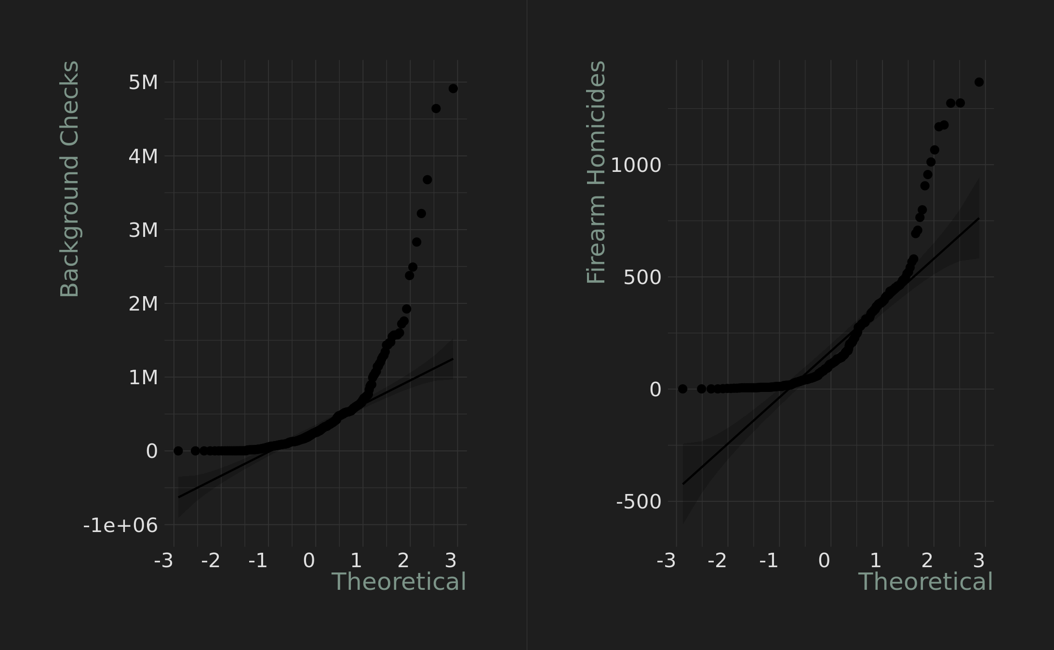
What does the data say?
Pearson's Product-Moment Correlation Test
P-value ~5.0894 e -19 (0.00000000000000000050894)
Correlation coefficient: ~0.524
Slightly Positive Correlation
Notes:
So I am going to be honest here this is not my strong area. Programming is what I am good at, statistics not so much. So I am going to try to interpret this data as much as I can and try to use Google to guide me to what this means.
I believe this means there is an ever so slight positive correlation between background checks and firearm homicide rates but no where near enough of a correlation to call it conclusive. The actual number is so small it is basically zero.
If I realized how long it would take to get the data that I initially wanted, I would have tried to submit the Freedom of Information act request earlier.

Slide 9
https://ucr.fbi.gov/crime-in-the-u.s/2018/crime-in-the-u.s.-2018/topic-pages/tables/table-20
https://ucr.fbi.gov/crime-in-the-u.s/2017/crime-in-the-u.s.-2017/topic-pages/tables/table-20
https://ucr.fbi.gov/crime-in-the-u.s/2016/crime-in-the-u.s.-2016/topic-pages/tables/table-12
https://ucr.fbi.gov/crime-in-the-u.s/2015/crime-in-the-u.s.-2015/tables/table-20
https://ucr.fbi.gov/crime-in-the-u.s/2014/crime-in-the-u.s.-2014/tables/table-20
https://www.fbi.gov/file-repository/nics_firearm_checks_-_year_by_state_type.pdf/view
https://www.fbi.gov/file-repository/nics_firearm_checks_-_month_year_by_state.pdf/view
https://www.pewsocialtrends.org/2013/05/07/gun-homicide-rate-down-49-since-1993-peak-public-unaware/

